Slide 2
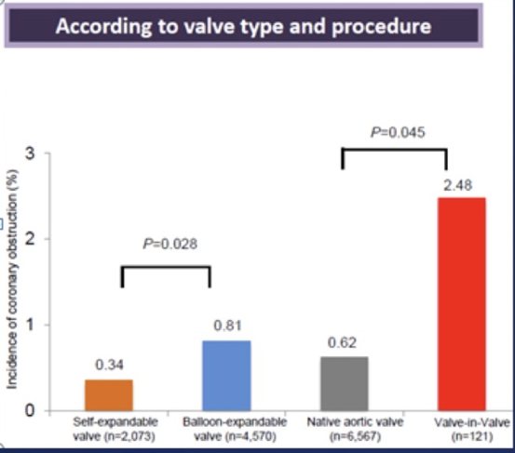
Mortality following coronary obstruction
Most present with immediate shock (68%)
* Despite 82% PCI success
30-day Mortality
Presented by A Greenbaum, SHDS 2018
Ribiero et al JACC 2013

Slide 3
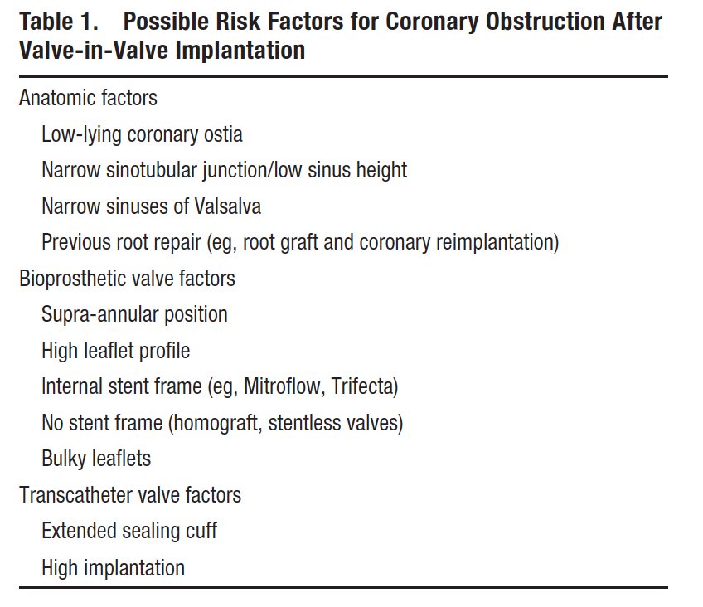
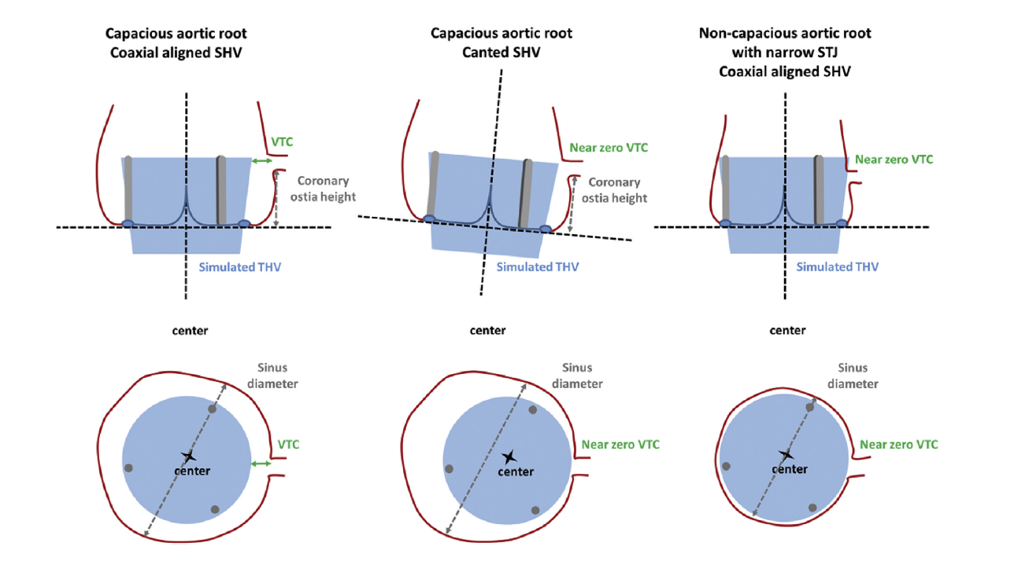
Predicting coronary obstruction is complicated
Dvir et al. Circ Cardiovasc Int 2015
Blanke et al. JCCT 2016
Presented by A Greenbaum, SHDS 2018

Slide 4
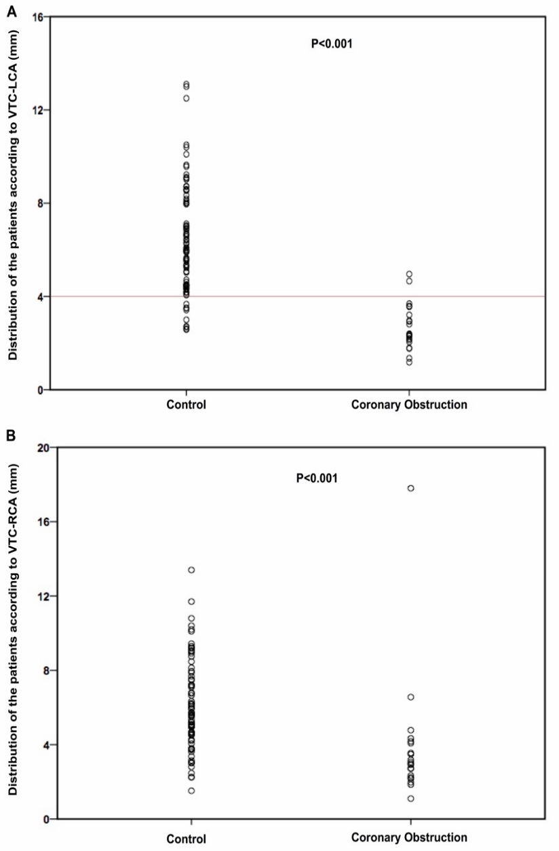
VTC for patients <4mm
Presented by A Greenbaum, SHDS 2018
Khan… Lederman JACC Int 2018
Ribiero et al Eur Heart J 2018

Slide 6
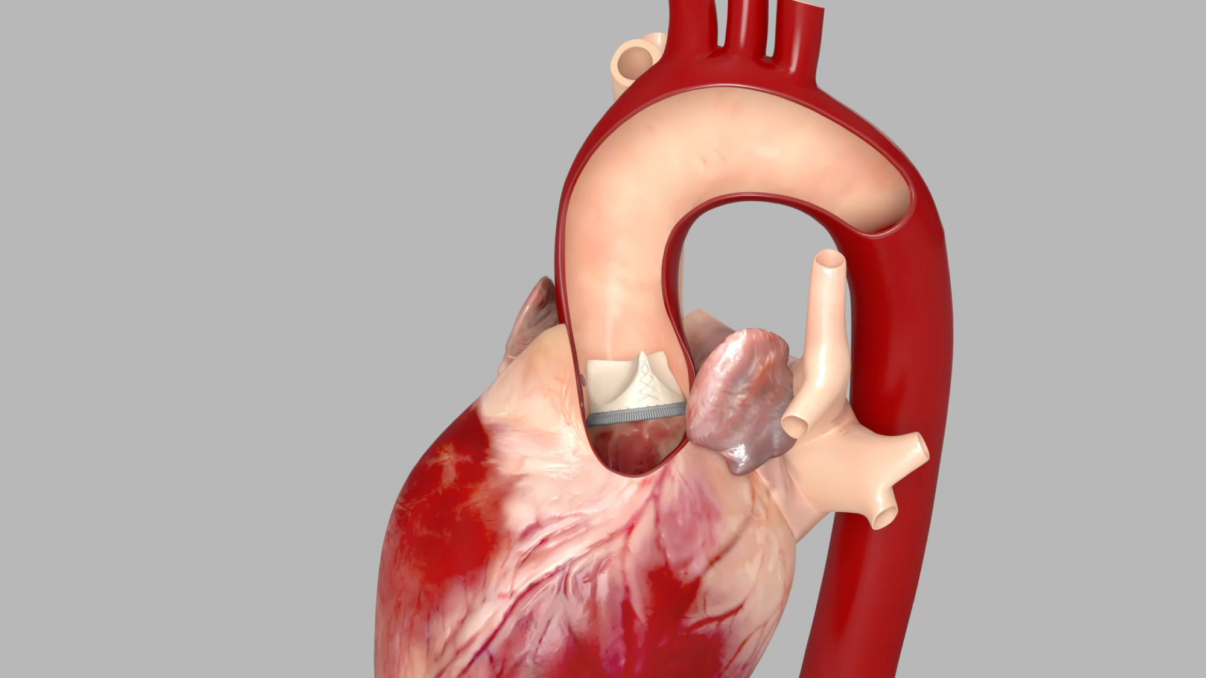
BASILICA
Presented by A Greenbaum, SHDS 2018

Slide 7
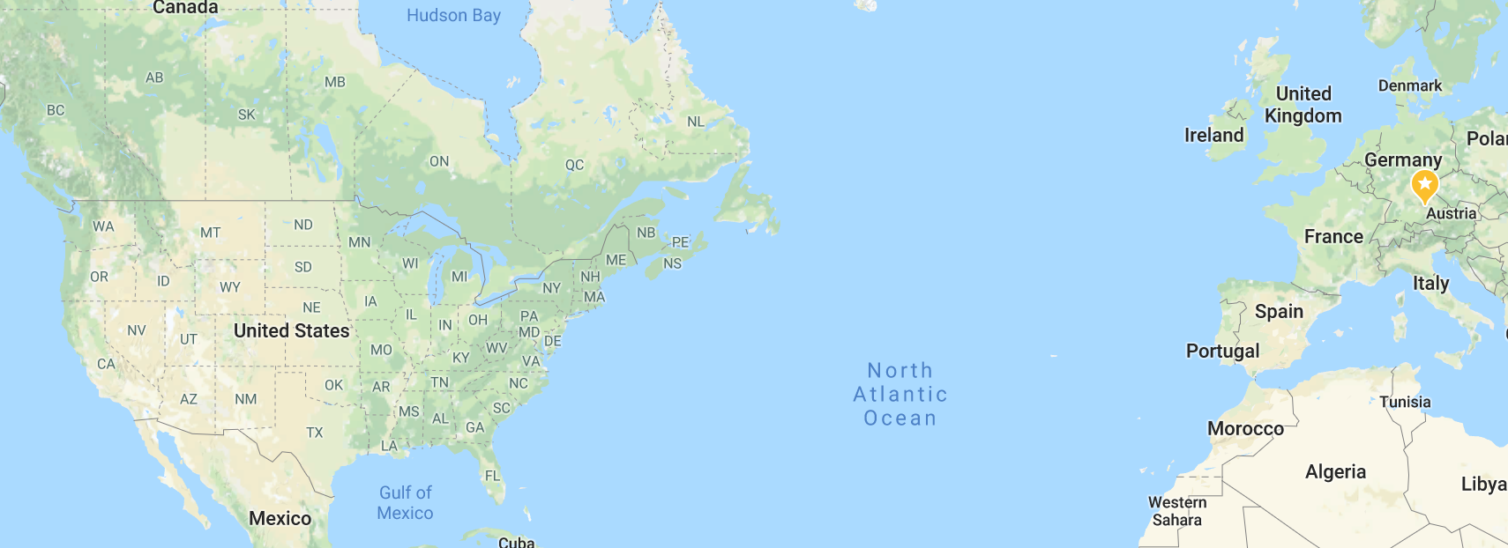
Translation to clinical care
First animal experiment
First in human case
Satellite broadcast of live case
46 patients treated in 9 centers
Jun 29 2017
July 17 2017
Nov 2 2017
June 18 2018
BASILICA
Presented by A Greenbaum, SHDS 2018

Slide 8
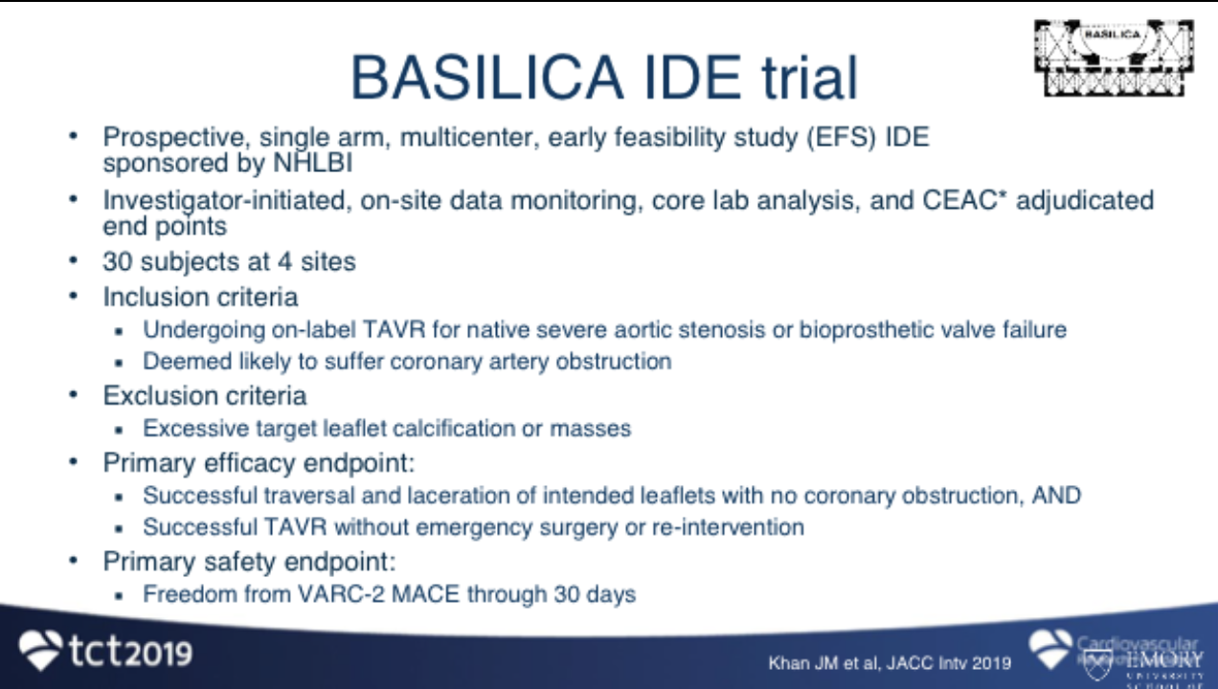

Slide 9
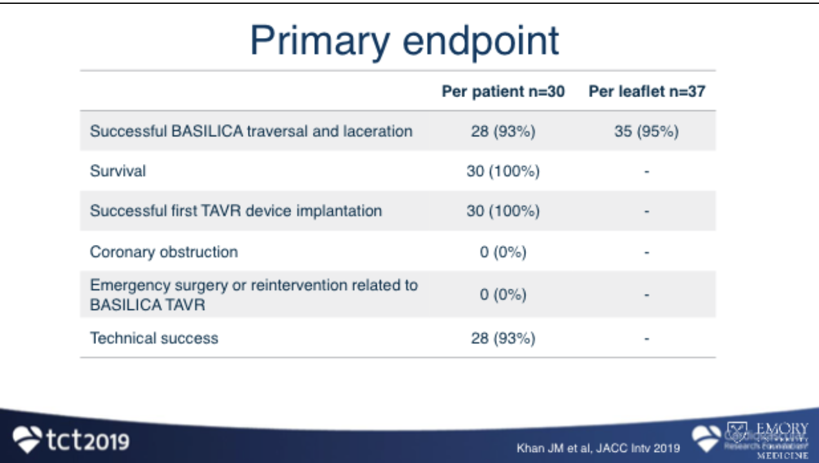

Slide 10
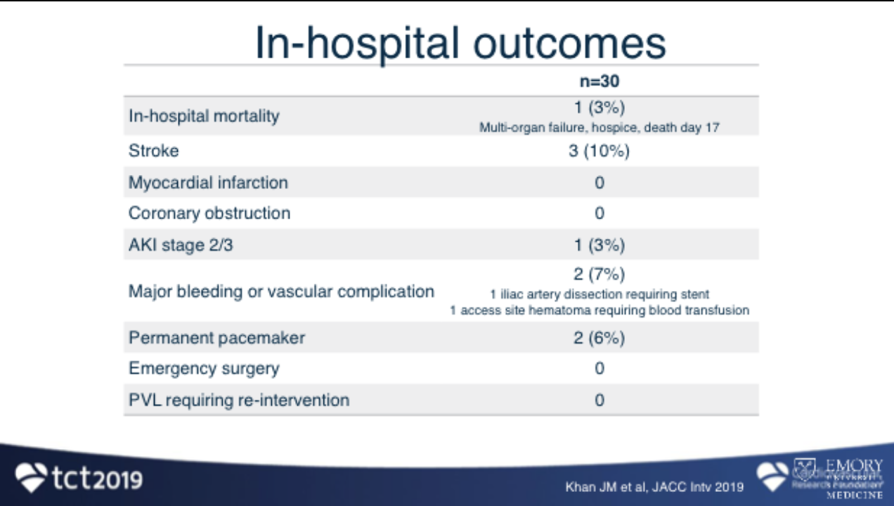

Slide 11
Case
83F
Asthma/HTN/PPM
2000 AVR Freestyle #23
  Prolonged post op course
  Reoperation for bleeding
  Slow rehabilitation
2018 recurrent CHF
  NYHA III
  Failing AVR with severe AI/global LV dysfunction/ RVSP 55 mm Hg
Assessed by two surgical centres as high/prohibitive risk for redo
  Patient herself declined redo SAVR
  DNR – no ICU, no prolonged intubation

Slide 12
CT measurements
Annulus
  Area 335mm2 Perimeter 64.2 mm. Diameters (20.4-20.6mm)
Sinus diameters 24-26 mm
Coronary Heights
  LCA 7.5, RCA 12 mm
VTC (assuming 20 mm annulus diameter)
  LCA 3.5 RCA 3.0
STJ diameter 25.5 mm
STJ Height 16.5 mm

Slide 13
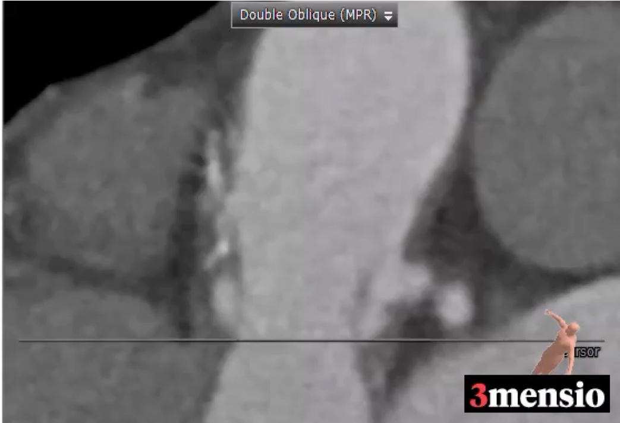
Pre MDCT, MPR image
Leaflets extend above both coronary ostium

Slide 14
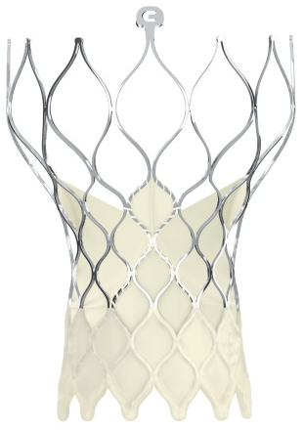
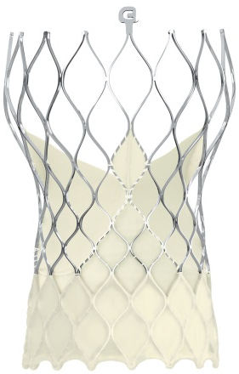
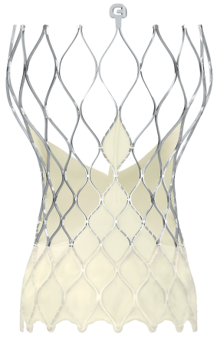
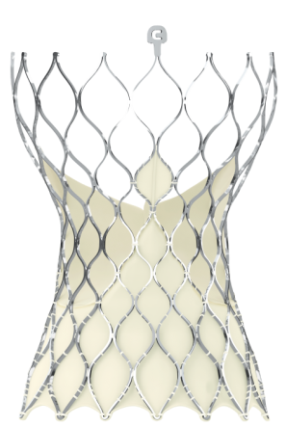
Evolut PRO/ Evolut R Patient Selection
Aortic Root Criteria
Valve Size Selection
Evolut R/PRO TAV
Evolut R TAV
Size | 23 mm | 26 mm | 29 mm | 34 mm
Annulus Diameter | 18 – 20 mm | 20 – 23 mm | 23 – 26 mm | 26 - 30 mm
Annulus Perimeter (π x Diameter) | 56.5 – 62.8 mm | 62.8 – 72.3 mm | 72.3 – 81.7 mm | 81.7 – 94.2 mm
Sinus of Valsalva Diameter (Mean) | ≥ 25 mm | ≥ 27 mm | ≥ 29 mm | ≥ 31 mm
Sinus of Valsalva Height (Mean) | ≥ 15 mm |  |  | ≥ 16 mm

Slide 15
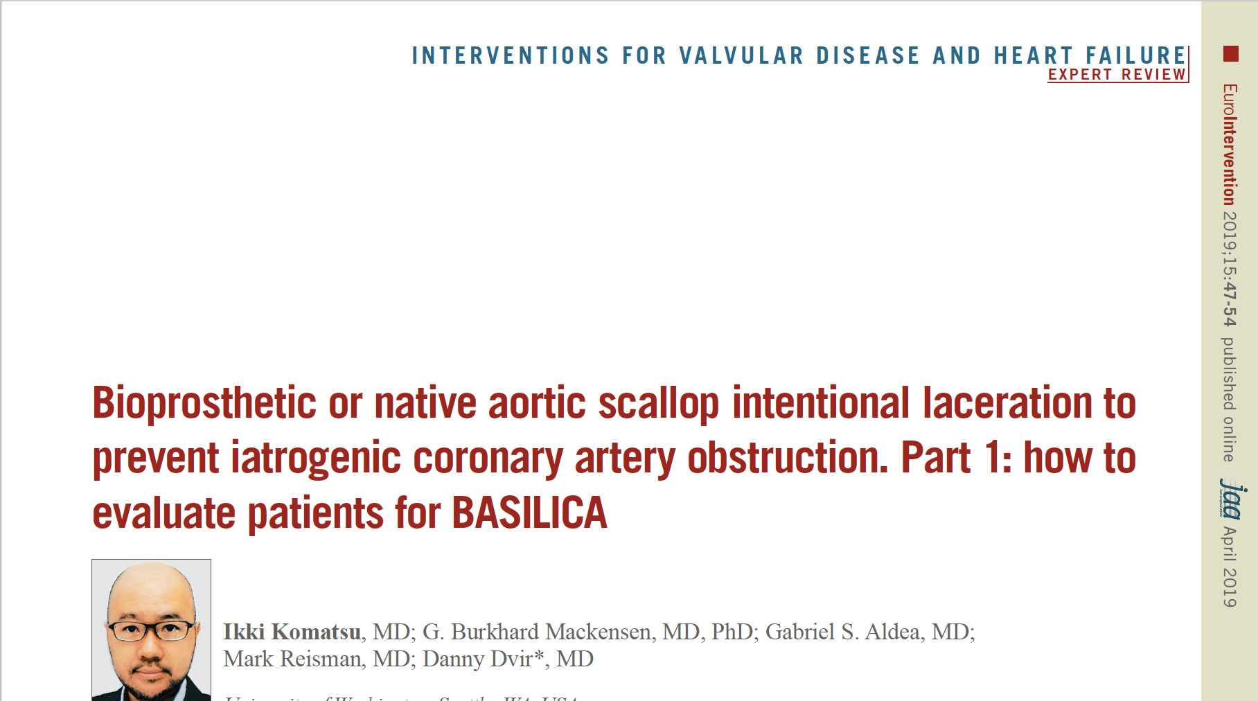
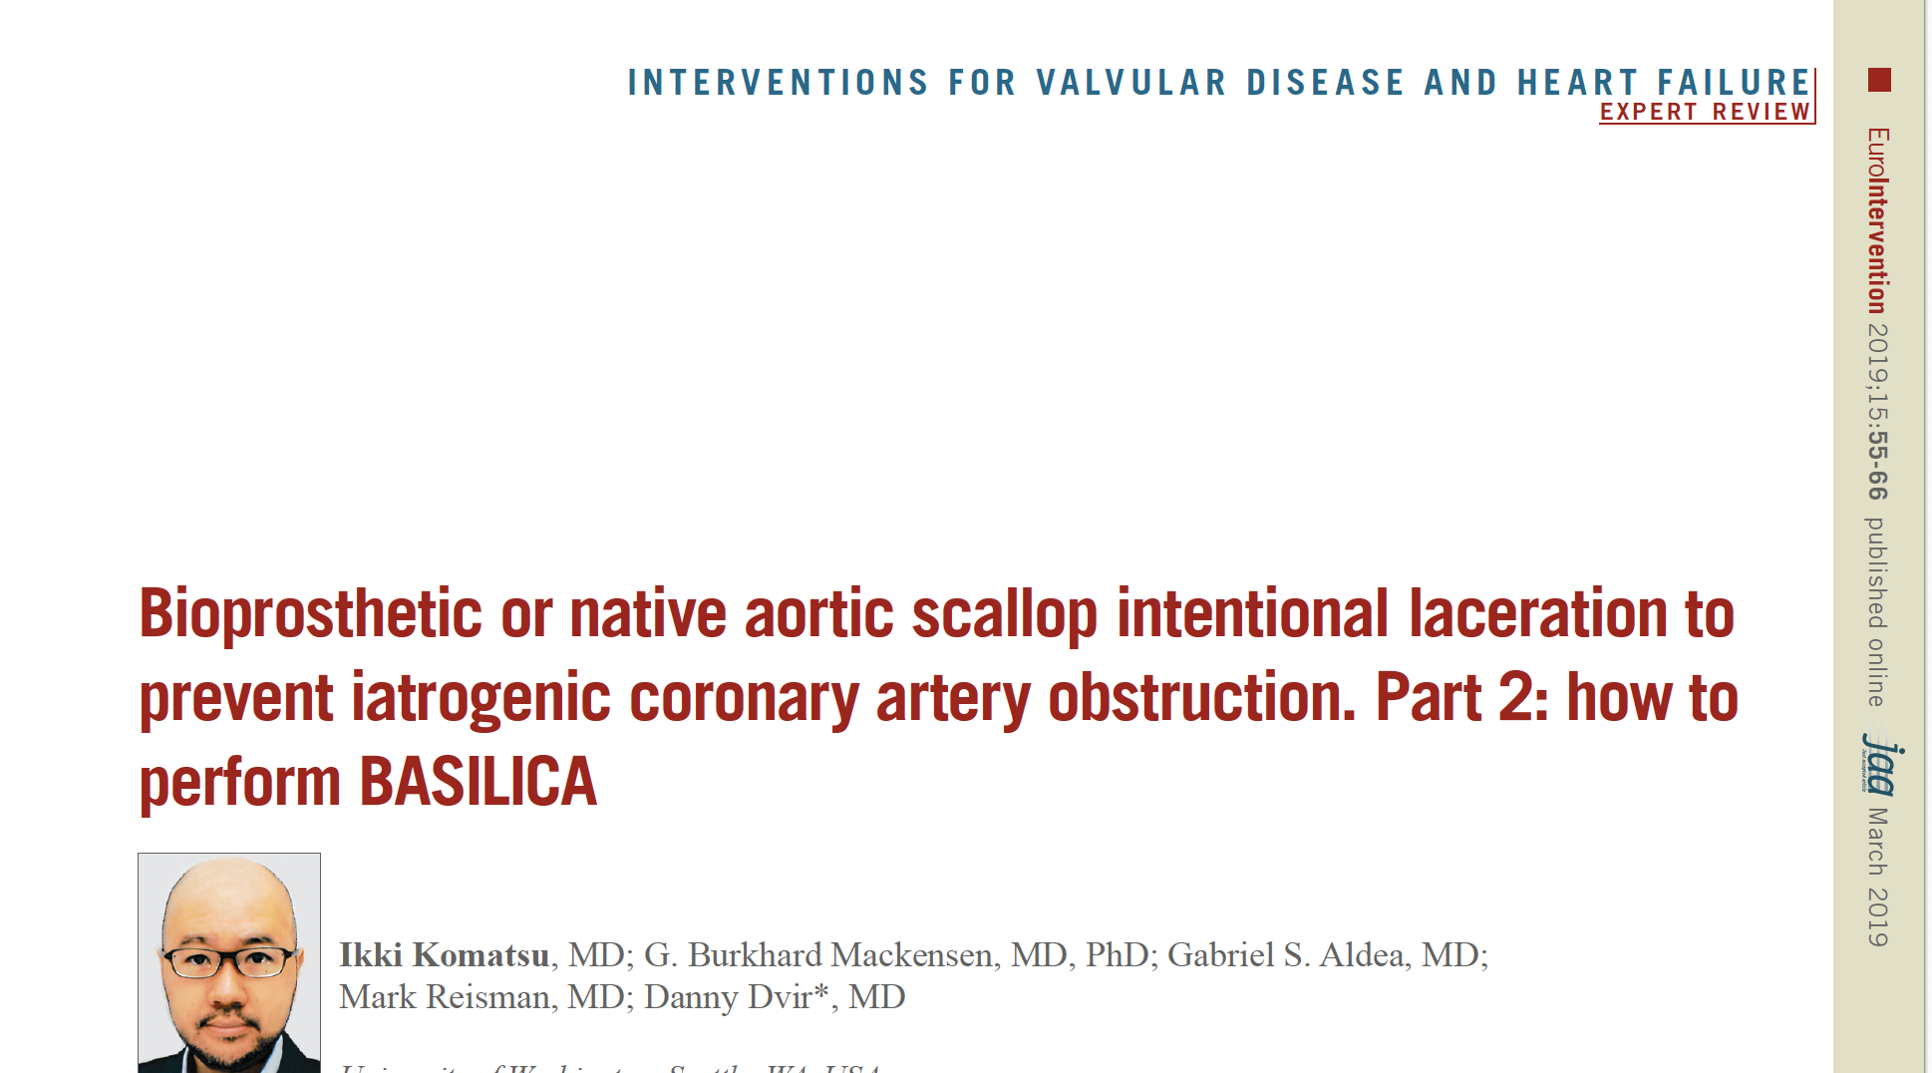
BASILICA Basics

Slide 16
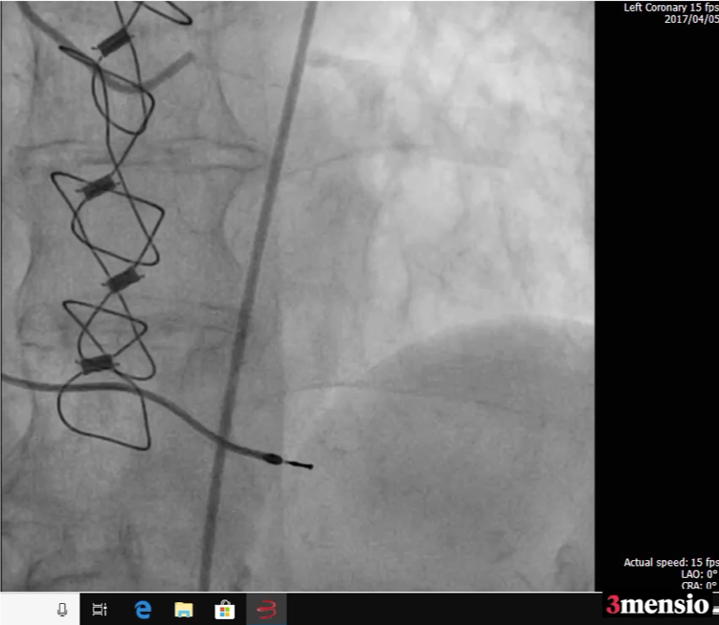
Pre coronary, aorta, leg angiograms

Slide 17
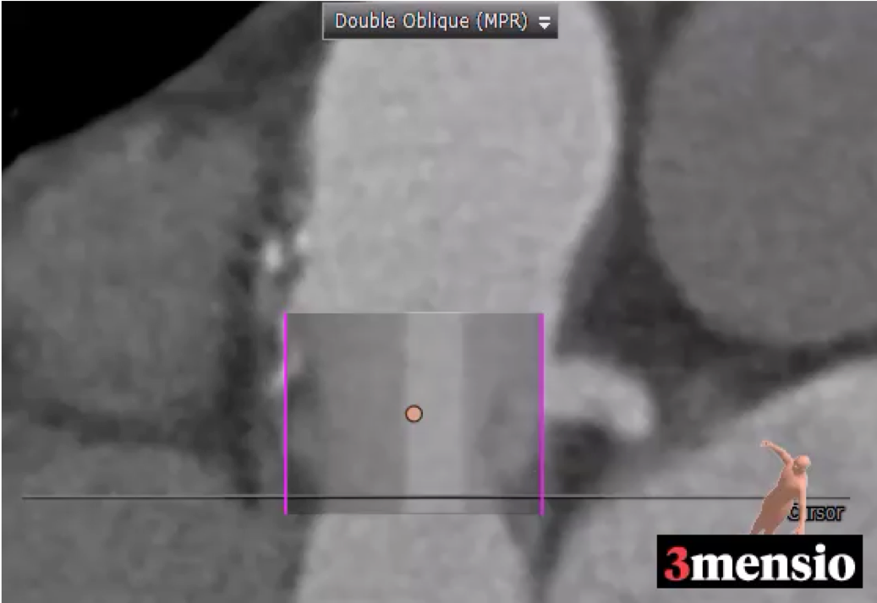
VTSTJ/ VTC for SapeinS3 23mm
RCA VTC 1.5
LCA VTC 1.5

Slide 18
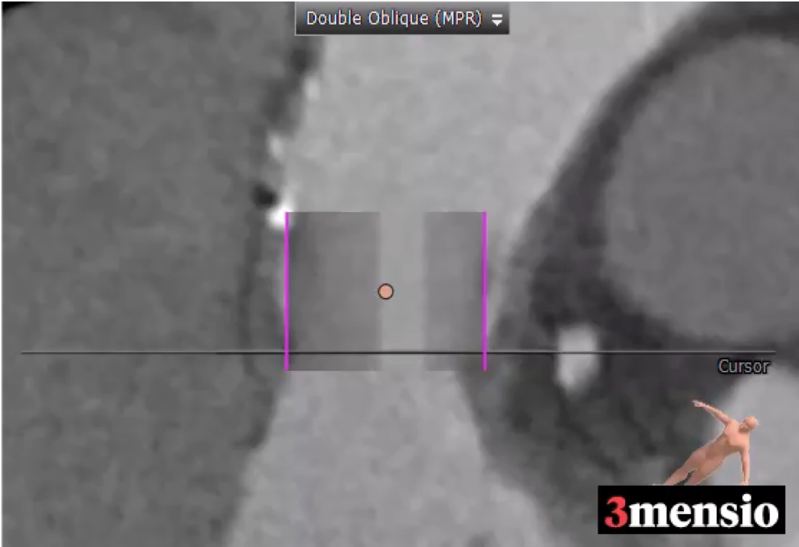
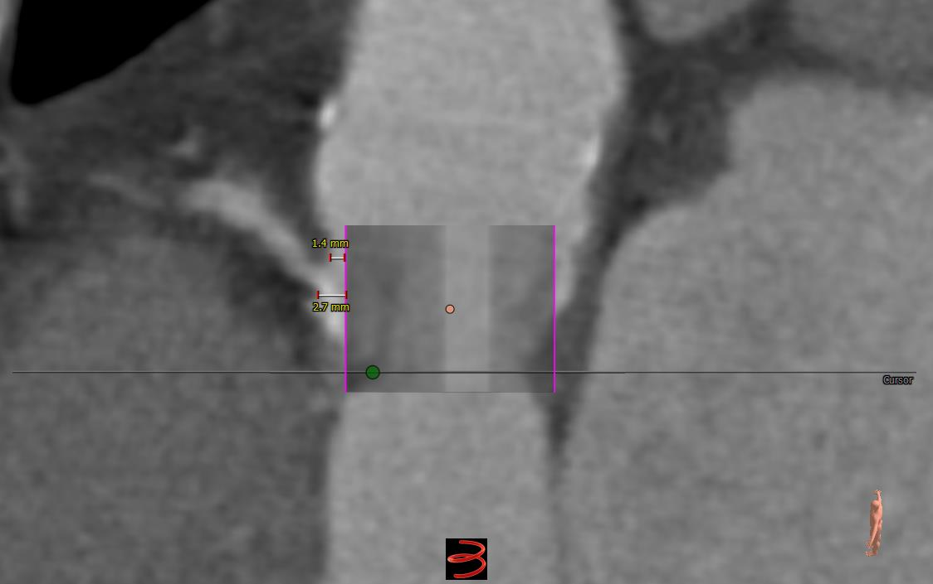
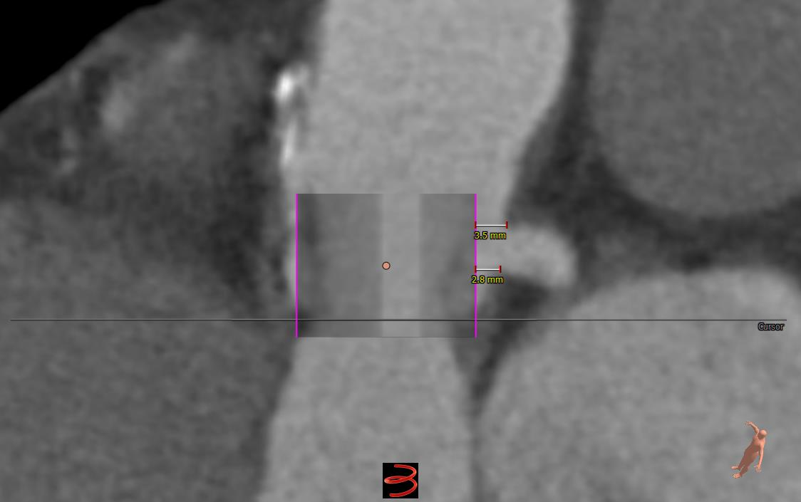
VTSTJ/ VTC for SapeinS320mm
RCA VTC 3.0
LCA VTC 3.5

Slide 19
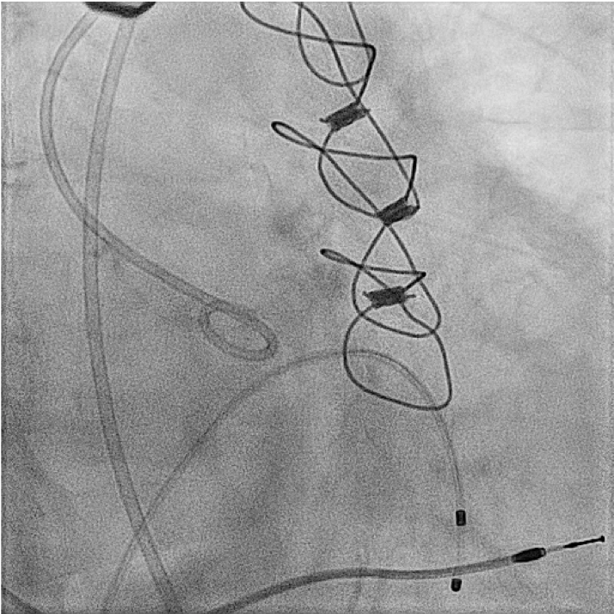
Angiogram
Access;
Rt: 18Fr Gore
Lt: 8Fr,6Fr double puncture

Slide 20
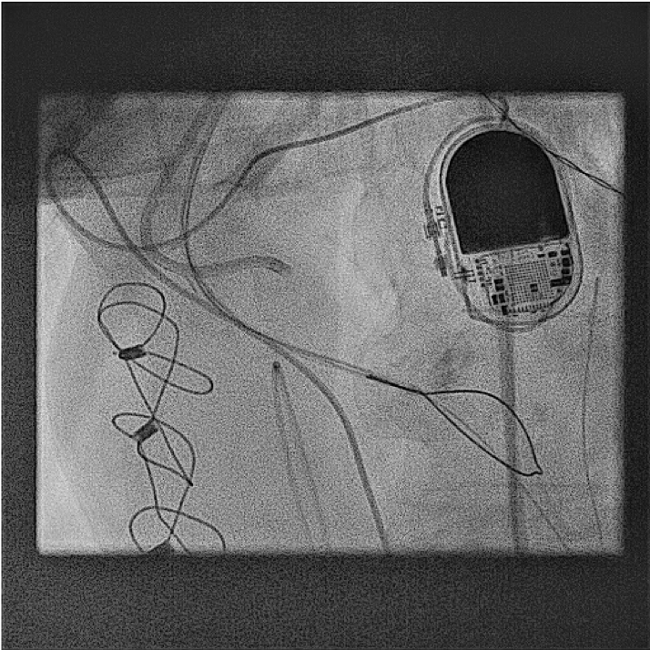
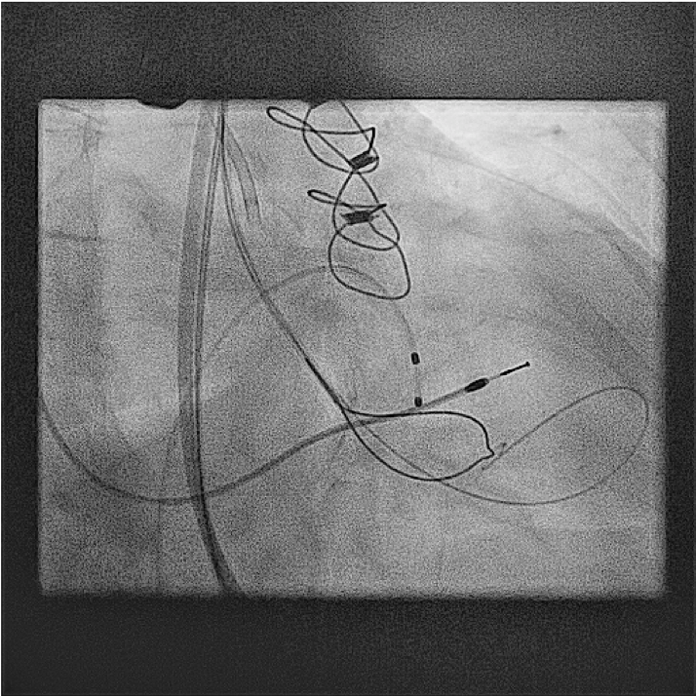
Pre LCC Side/Front view
-AL3.5 8Fr guiding catheter
-25mm Snare guide in 6Fr MP
LAO 37 CRA 36
Usually start with higher risk coronary cusp first
RAO 25 CAU 33

Slide 21
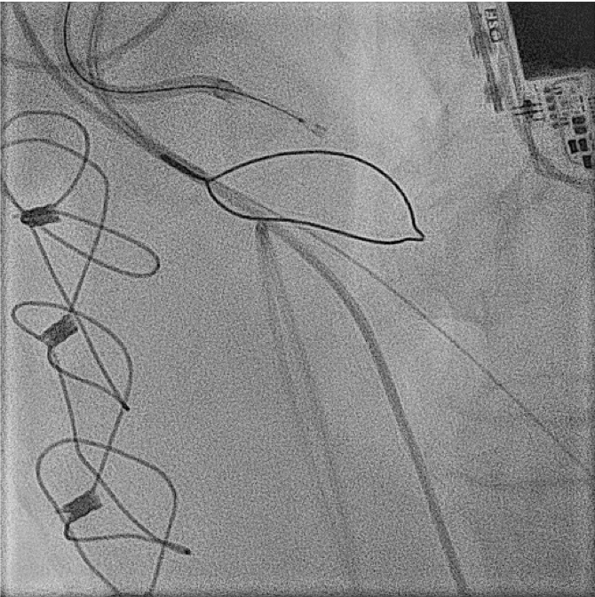
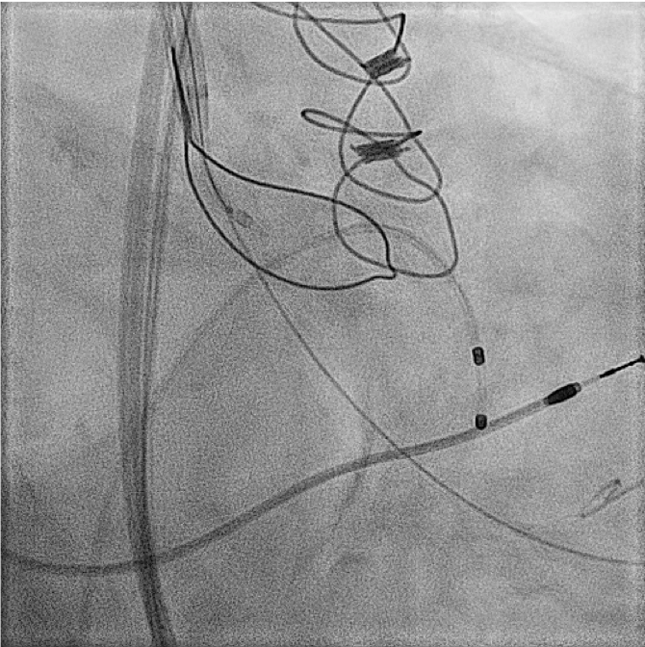
Traverse catheter positioning
-AL3.5 8Fr guiding catheter+ 5FR JR4.0 120cm, AstatoXS20mm 300cm, Piggyback

Slide 22
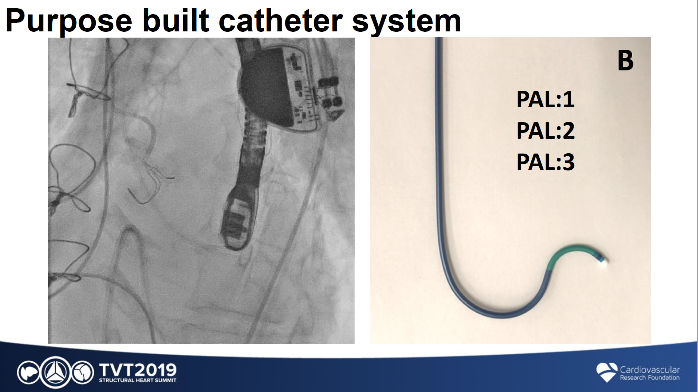
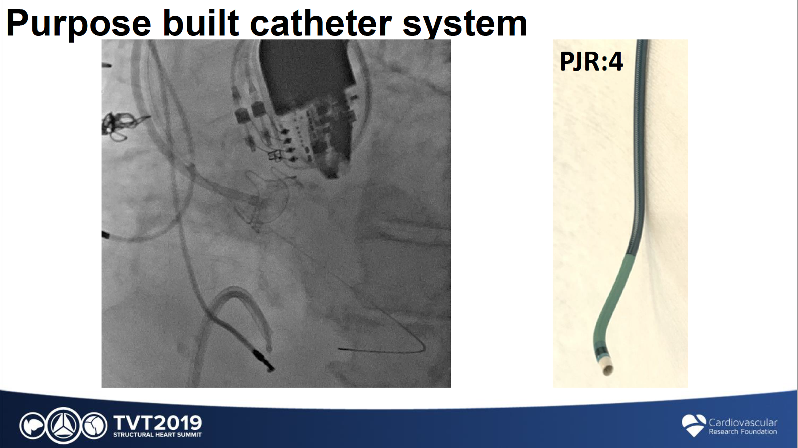
Pachyderm Shaped Dedicated Guides
J Lisko, TVT 2019

Slide 23
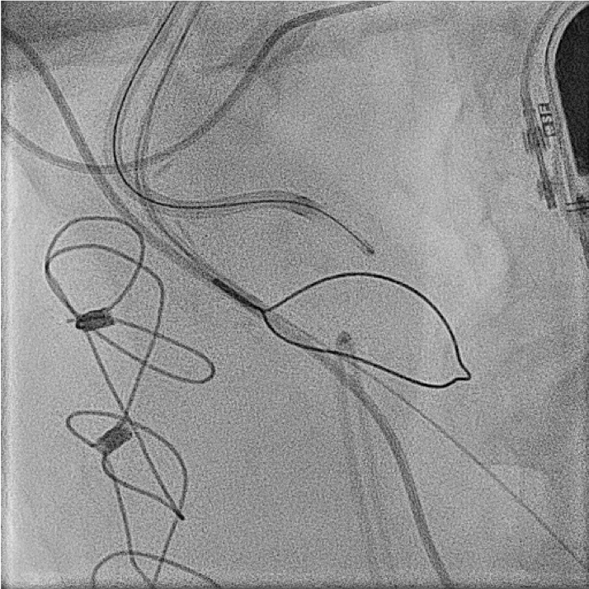
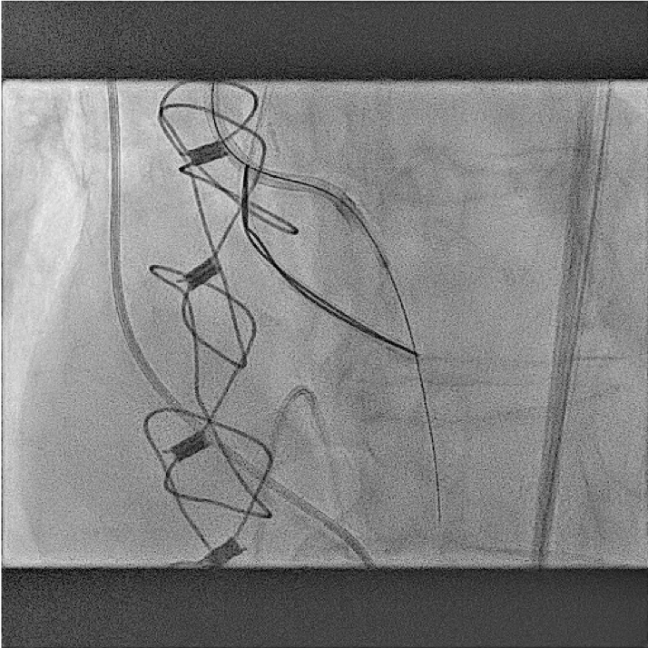
LCC traversal, wire snaring
Traverse with 30W

Slide 24
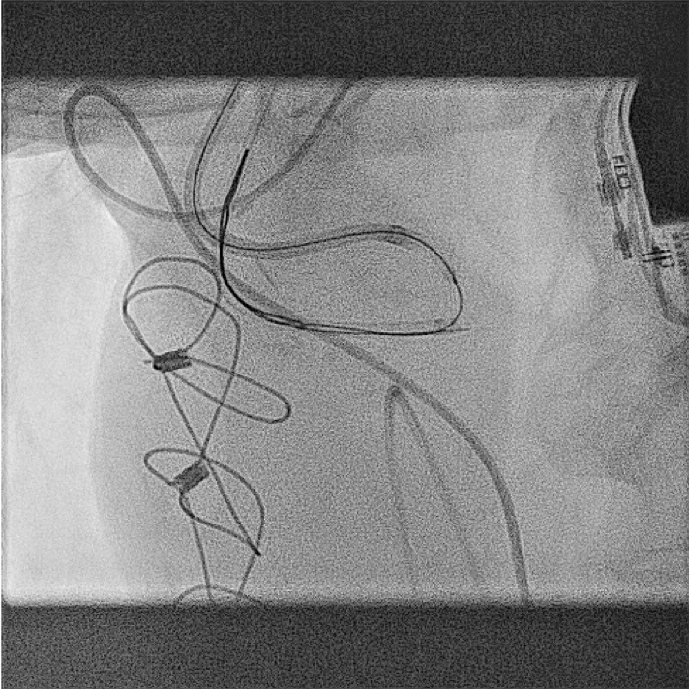
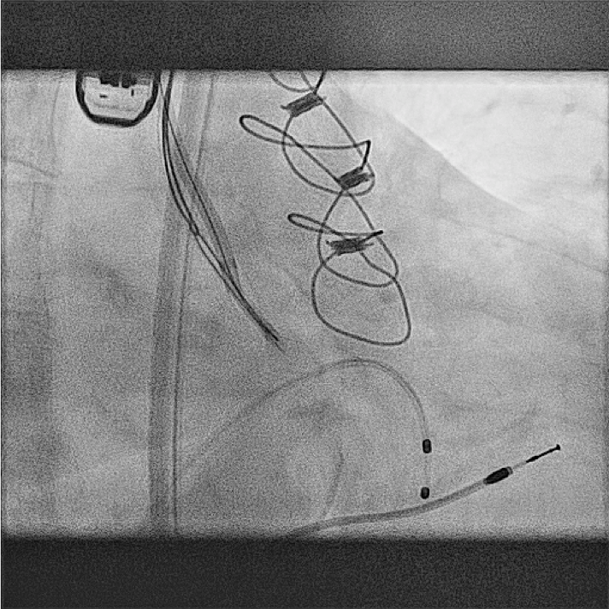
LCC injection
-good center and deep traversal

Slide 25
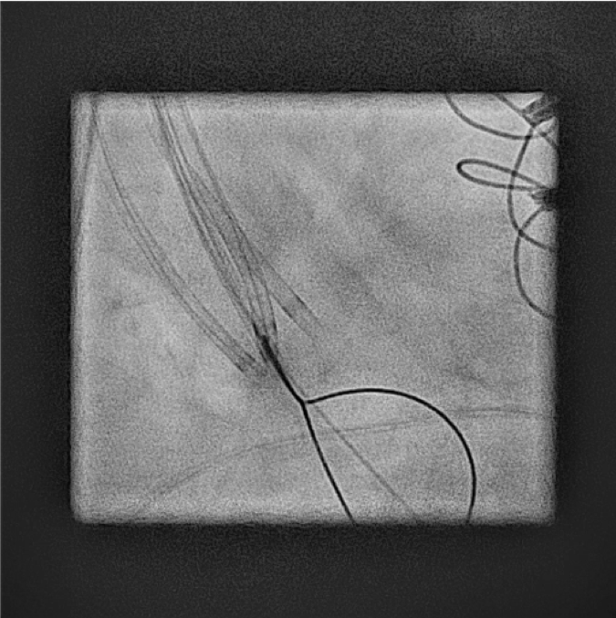
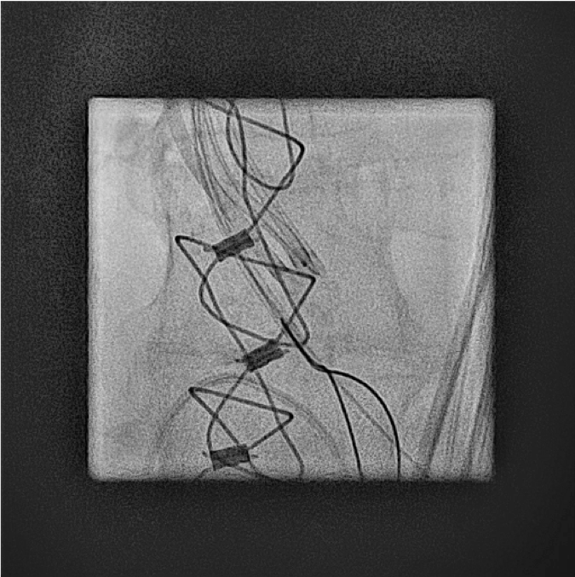
Pre RCC Side/Front view
RAO 40 CAU 33
LAO 2 CAU 10

Slide 26
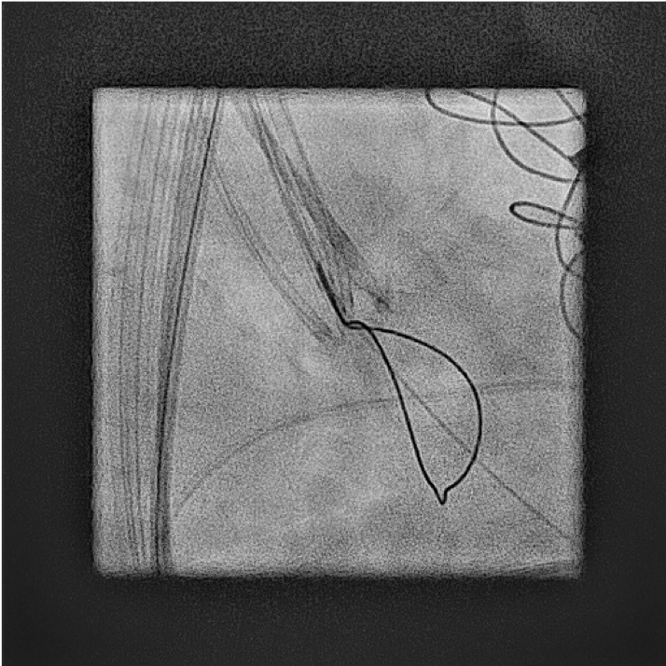
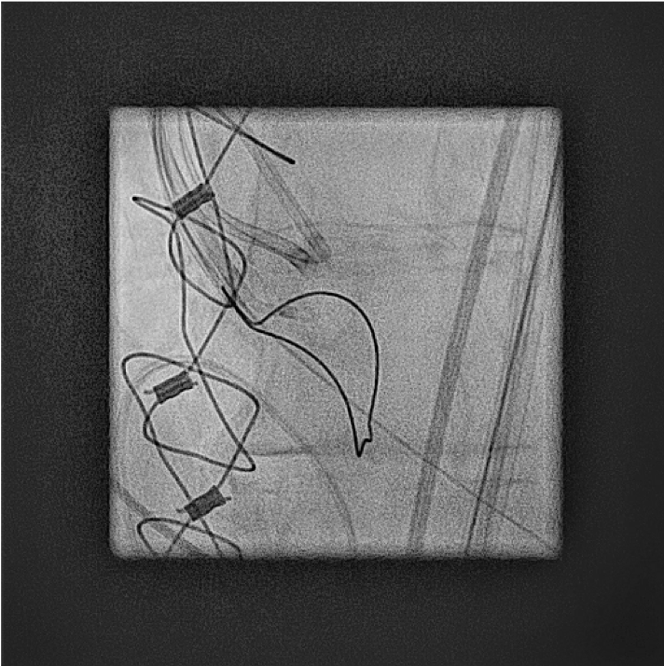
Traverse catheter positioning
-MB1 8Fr guiding catheter+ 5FR JR4.0 120cm, AstatoXS20mm 300cm, Piggyback

Slide 27
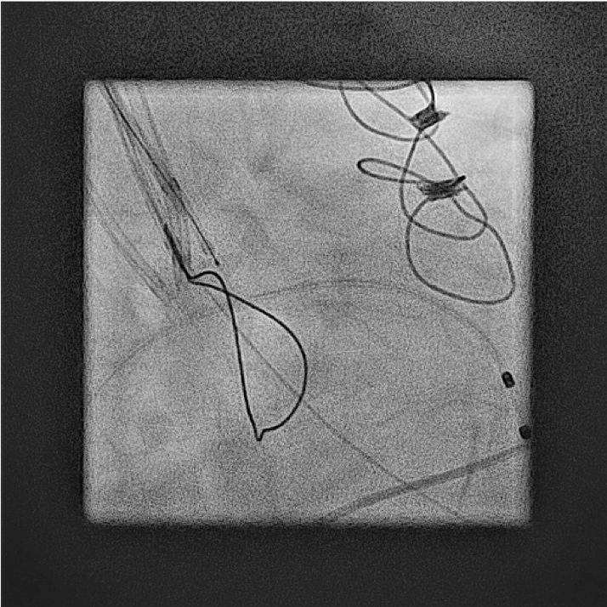
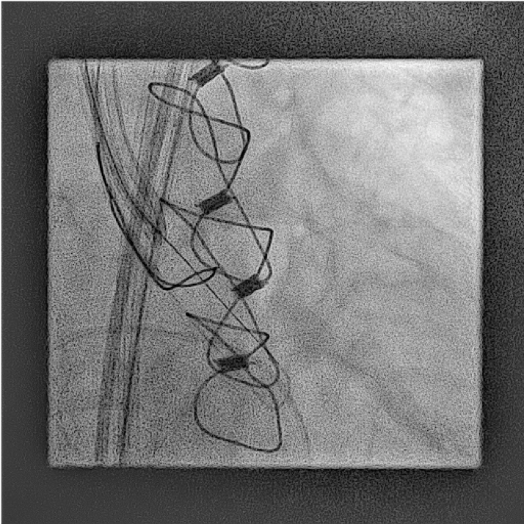
RCC traversal, wire snaring
Traverse with 30W

Slide 28
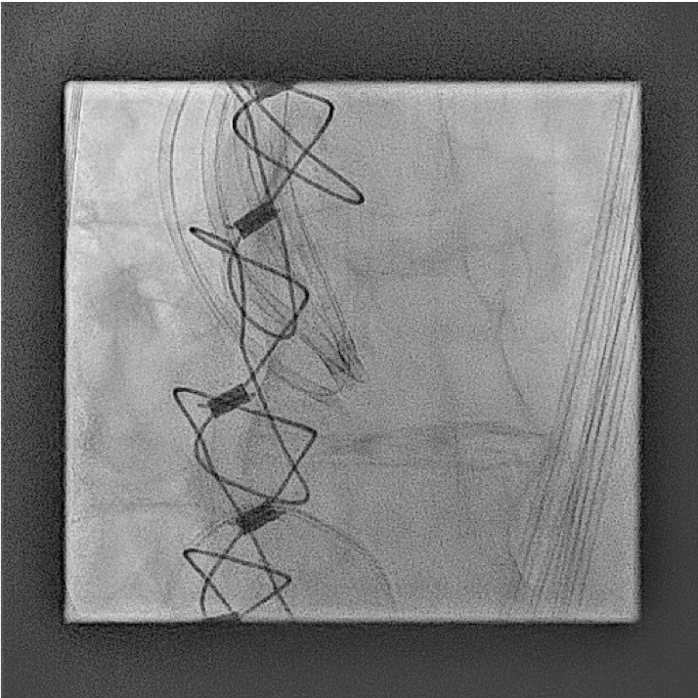
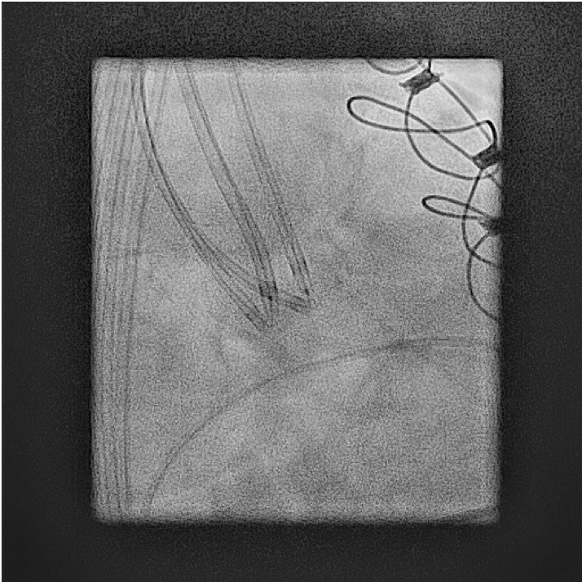
Bring V shape
Double V shape

Slide 29
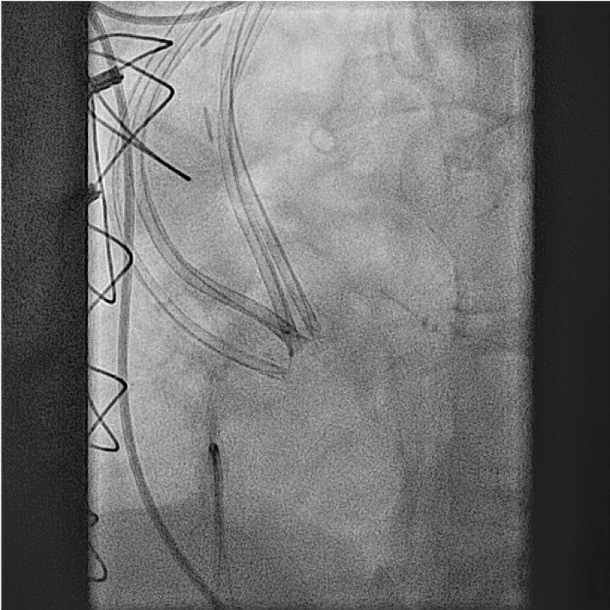
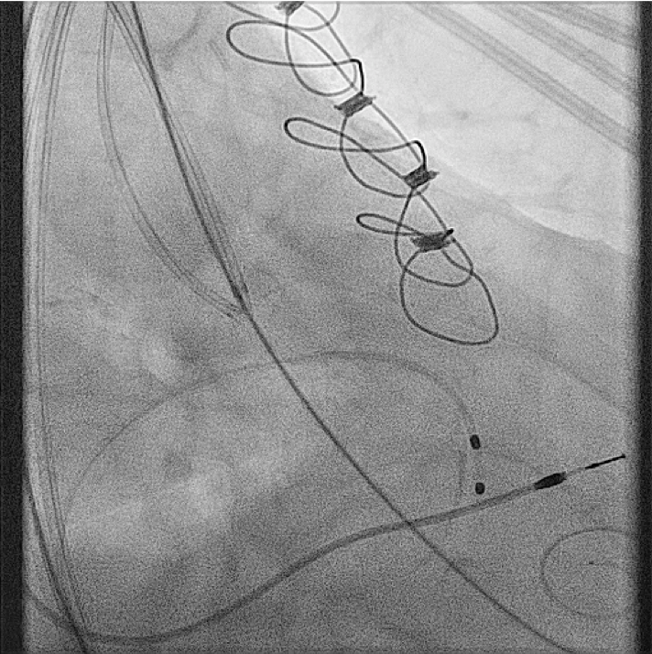
Lt->Rt leaflet laceration with 50W

Slide 30
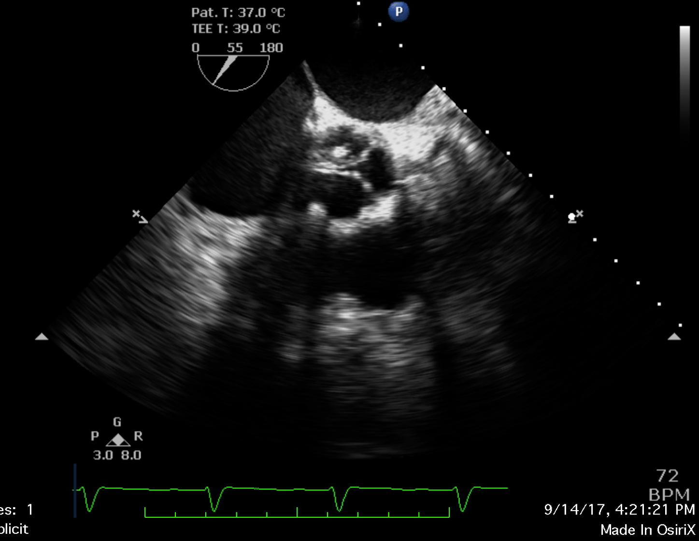
Presented by A Greenbaum,
SHDS 2018

Slide 31
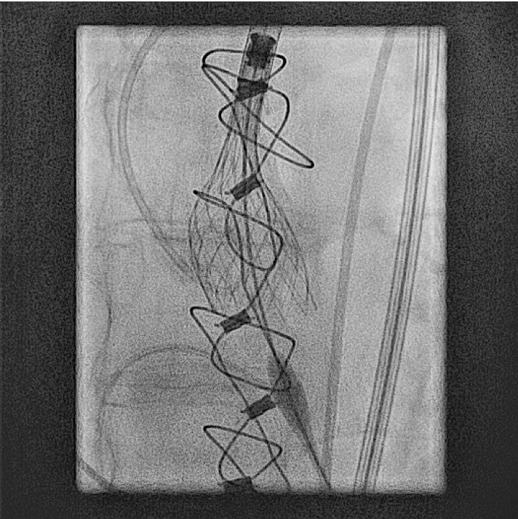
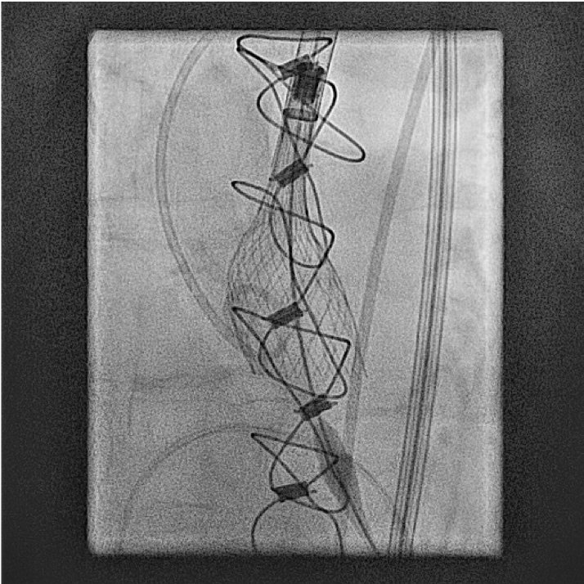
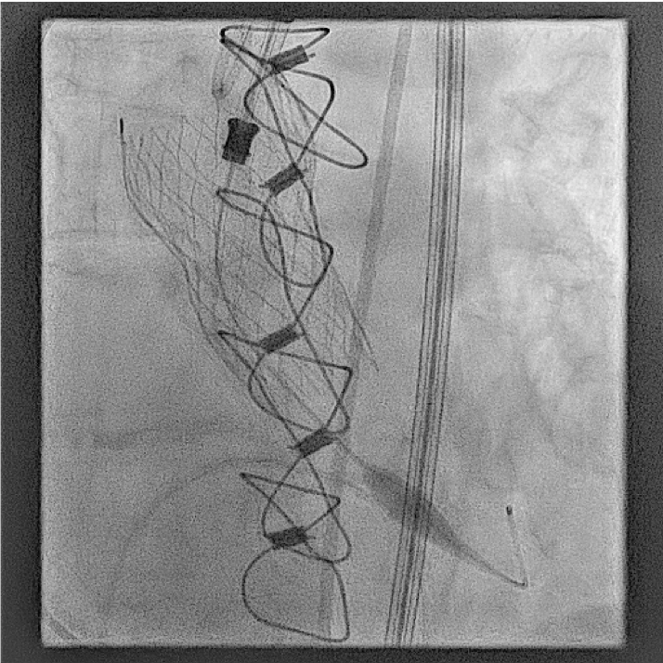
THV implantation

Slide 32
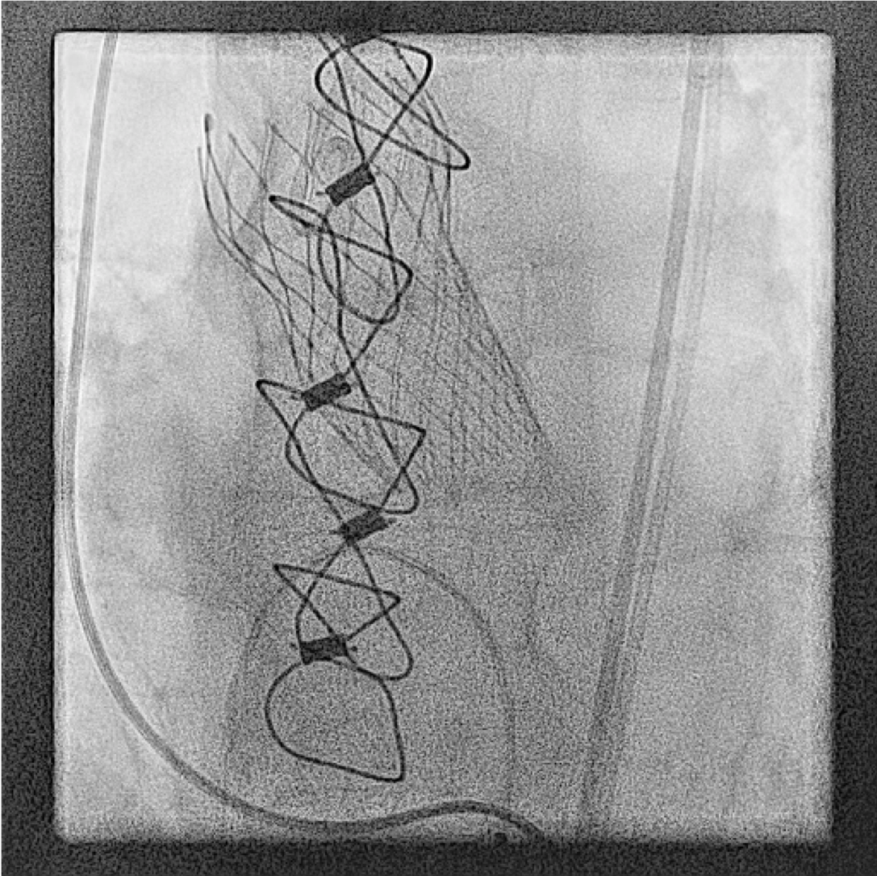

Slide 33
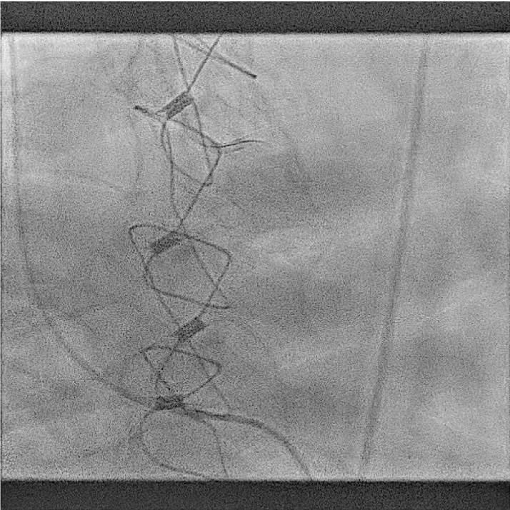
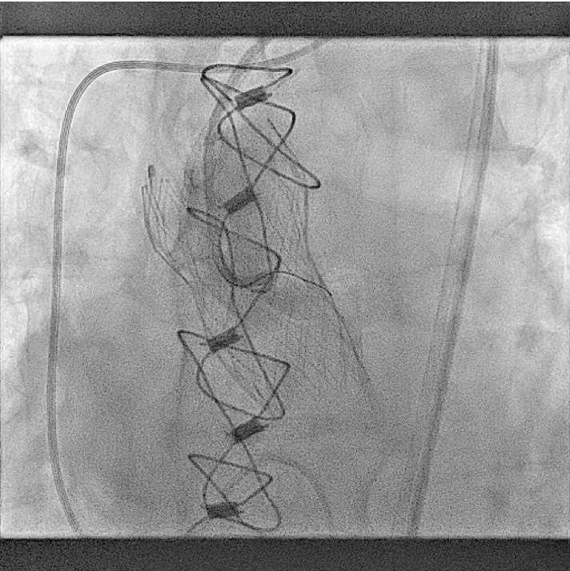

Slide 34



Slide 35
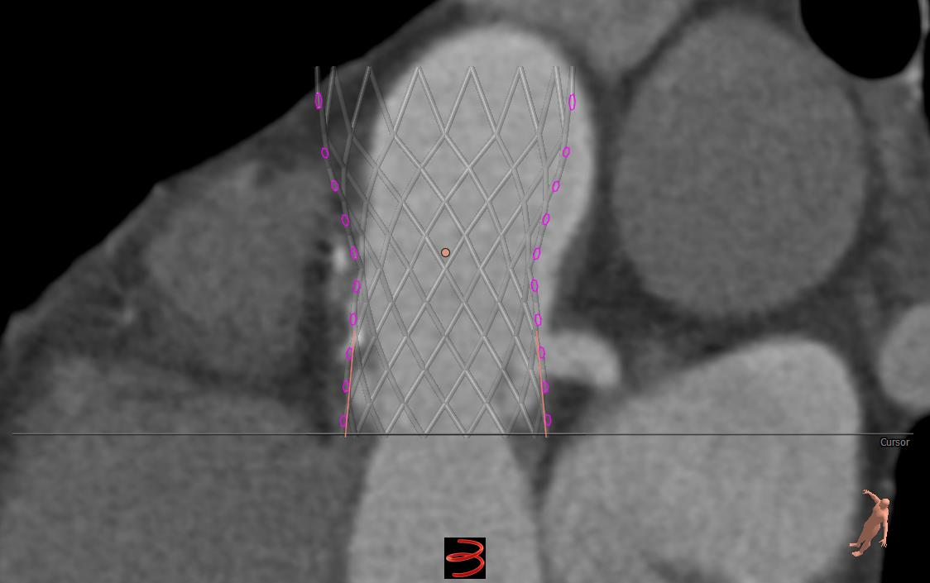

High vs Deep implant

Slide 36
Tough Lessons Learned
SWEAT THE DETAILS
Attention to THV structure/dimensions
  Skirt!
  3D modelling?
Attention to depth
?Consider commissural alignment possibilities
Release in:
  ‘ideal position’
  AND
  ‘ideal imaging angle’

Slide 37
IMPLANTATION TECHNIQUE

